Slide 1

Marketing our Collections - Marketing our Libraries.

Slide 2
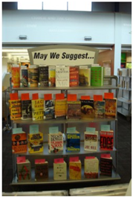
Traditional Book Displays – YEAH!
Use few words and large print
Give them something extra
“bookmark” list of read-alikes, titles by genre, Large Print Lable, ect.
Have the book cover face out whenever possible
Change it up! Don’t get stale!

Slide 3
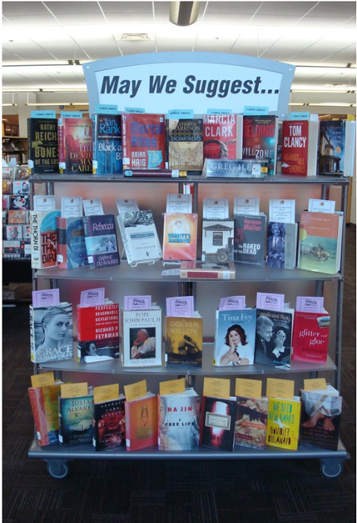

Slide 4
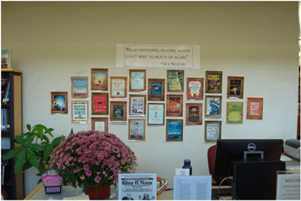
Do something unexpected… and fun to look at.

Slide 5
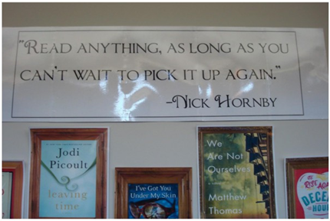
This is a laminated banner with a quote over “framed” book covers.
The framed covers were made up by searching Google Images of “wooden picture frames”. Copy and paste the photo of a wooden frame onto a Publisher blank page and expand it out to fill the page. Make a color copy of a book cover, place it inside a frame and laminate. Then just stick cover onto the wall.

Slide 6
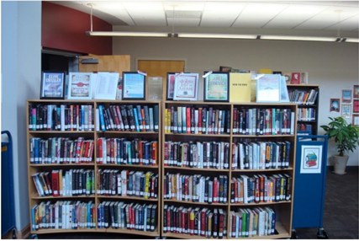
We used the same “framed book cover” concept to showcase our New Fiction collection except that we use real plastic frames so they could stand upright. This way our patrons don’t have to reach up to select their book and we don’t have to keep refilling!

Slide 7
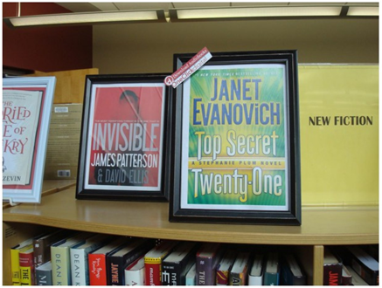
Here’s a close-up of a copied book cover in a plastic frame. You can also promote downloadable copies of a title by adding a small laminated promotional logo.

Slide 8
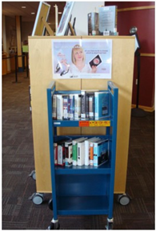

Ye Old Audiobook Cart
Place in a high visibility location and keep it well stocked. Also, a good time to remind patrons about downloadable audiobooks!

Slide 9
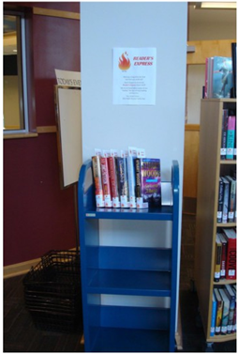
Take a copy of a “hot” title and turn it into a “Reader’s Express” hot pick. All you need is a cart, and informational flyer, stickers and an informational bookmark to insert in the book.

Slide 10
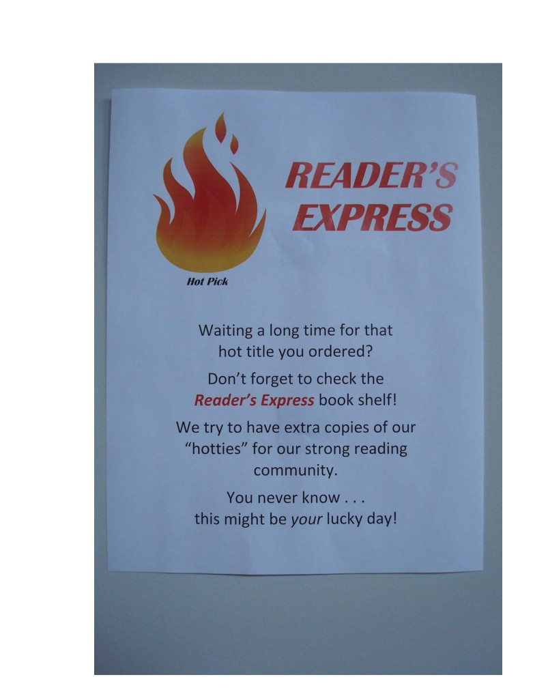

Slide 11
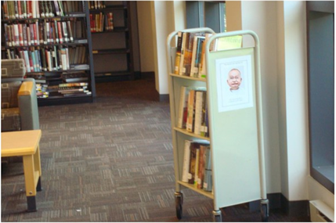
Here’s a “Why haven’t you read me yet.” cart. This is a cart full of fiction that was placed in a seating area in the non-fiction section. The Following day it was relocated to a different location. Bring the books to the people and boost your circulation numbers!

Slide 12
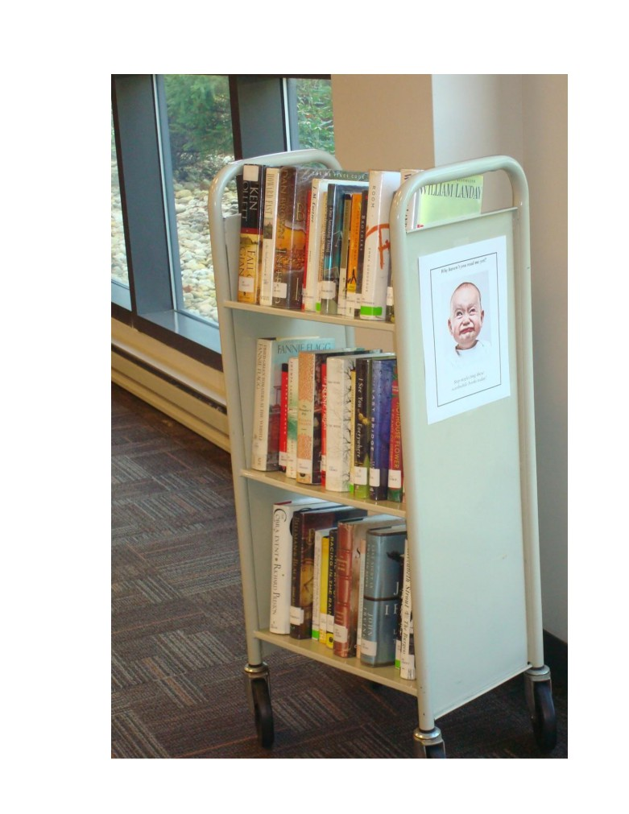

Slide 13
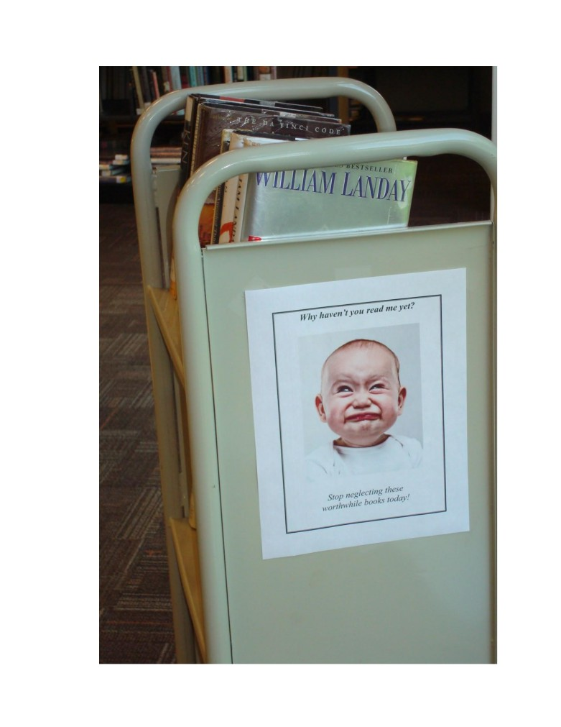

Slide 14
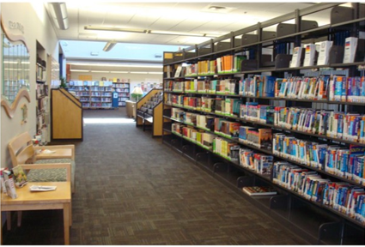
If you have a seating area by a special collection (here’s is out Travel section), then you could pull out a few books and pull together a display. It will help people to notice the special collection.

Slide 15
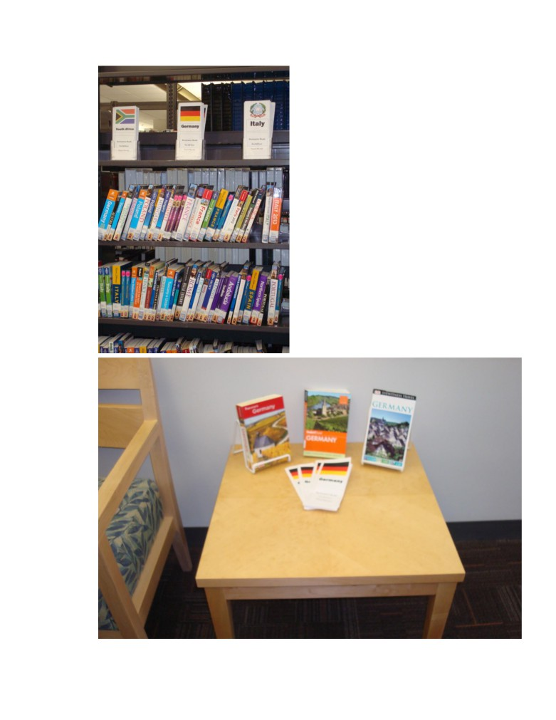

Slide 16
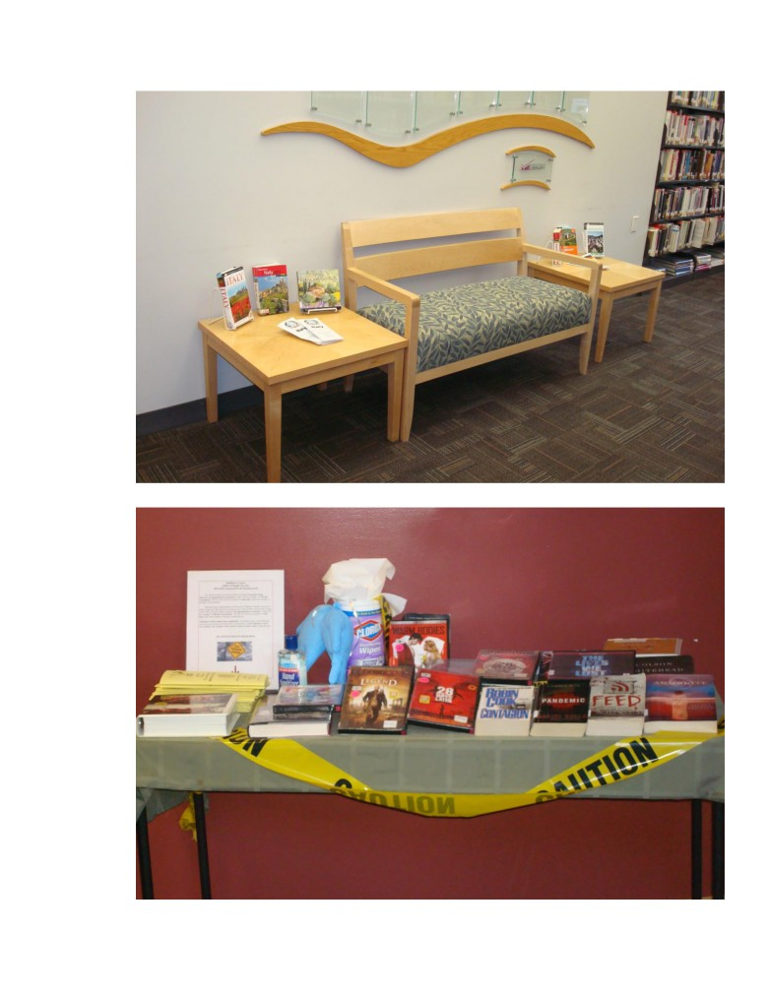

Slide 17
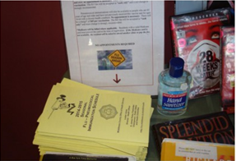
Another way to have your traditional displays do “double duty” is to combine events. This is a scary books/print/audio and movies about viruses readers’ advisory display along with a community service announcement. Get your flu shots here!

Slide 18
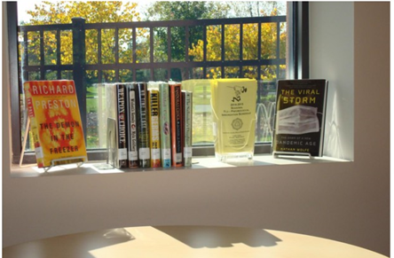
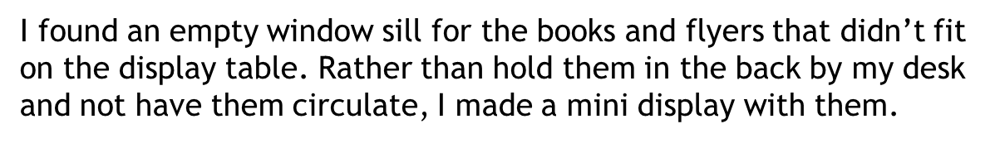

Slide 19
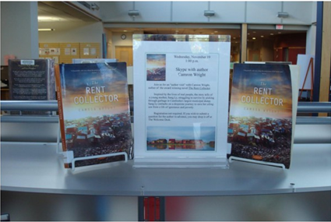
Displays for author events such as:
Author visits (this is for a Skype visit
Author birthday notice
Author death notice
A “while you wait” for the author to publish the upcoming title display their previous work (mix it up, include print, audio and movies if applicable)

Slide 20
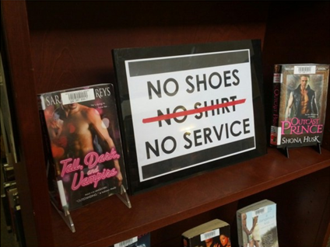
Here’s a display idea from Jesse Henning, a librarian in Ohio. This is what he has to say on his philosophy on book displays:
“I’m a firm believer in book displays being 3 things: pretty, funny and always on the edge of being taken down by administration.”
** Summer Reading 2015 **
Heroes: Escape the Ordinary (adult theme) ideas:
Biographies display
Literary Heroes
James Bond, Sherlock Holmes, Jay Gatsby, Jason Bourne, Horatio Hornblower, Atticus Finch

Slide 21
Book Marketing on Social Media!
You can take many of the same concepts you use to display books in your library and use them on your social media accounts.
Social Media also allows you to get very creative in how you market books and you libraries.
Discussed in this section
Tumblr
Instagram
But ideas can be used across platforms

Slide 22
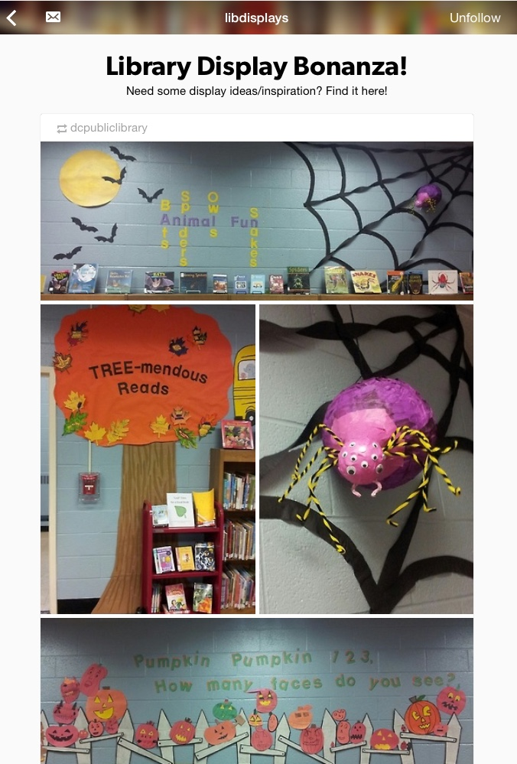
The simplest way is to just take photos of your book displays and share them online.

Slide 23
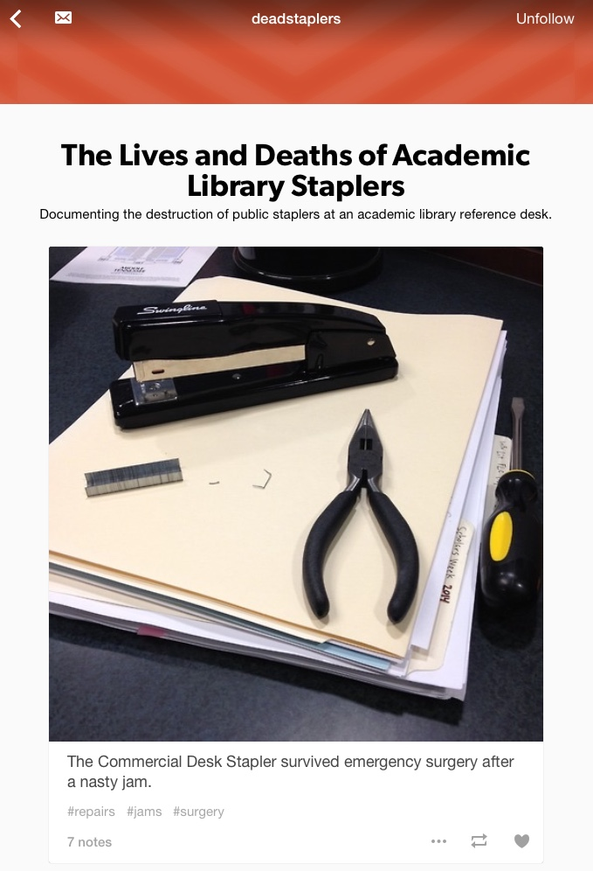
Find something unique about your library or your staff

Slide 24
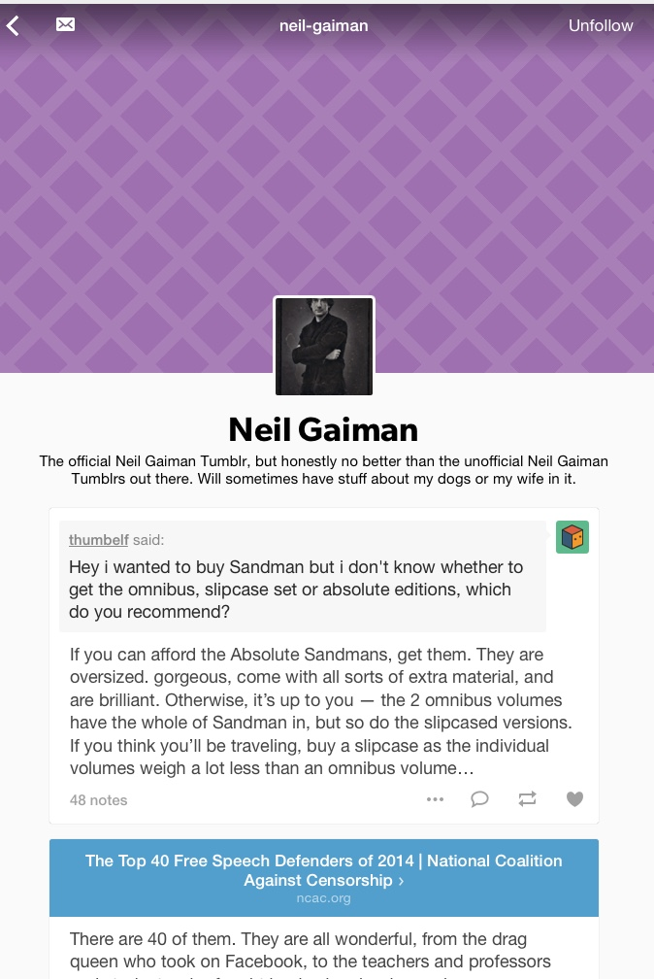
Use social media to interact with your patrons.
Book talks, Librarian Q&A, ect.

Slide 25
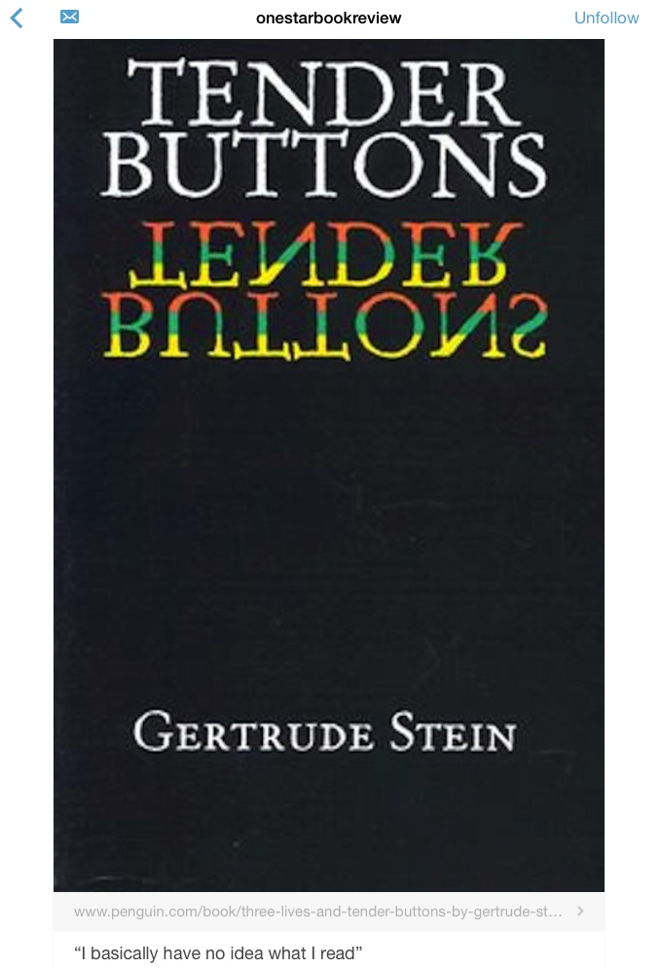
Share staff or patron book reviews.
(one or five stars)

Slide 26
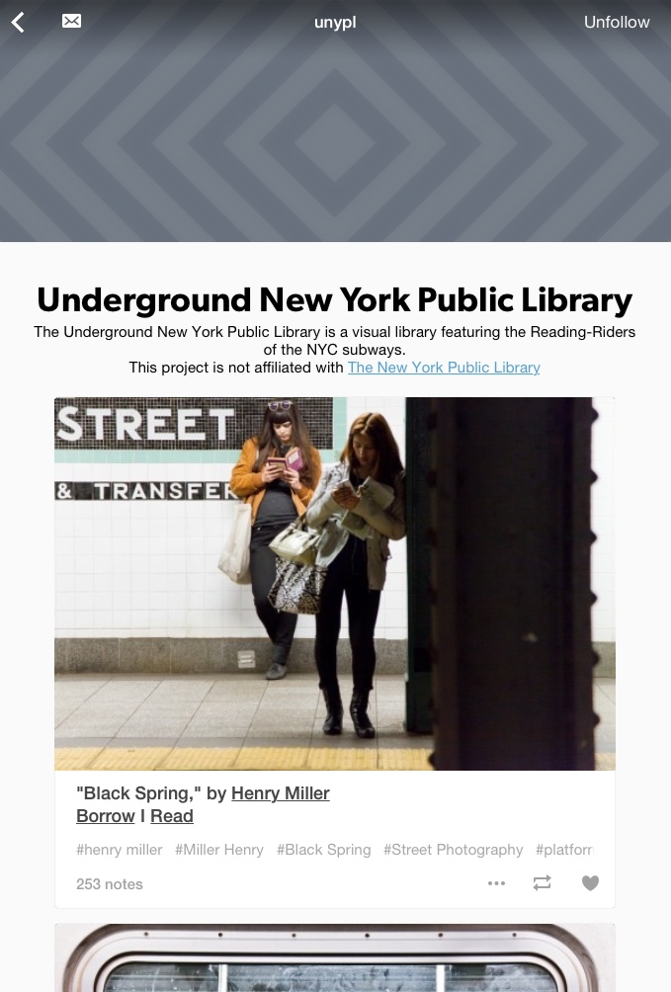
Share pictures of you patrons reading in the library or ask them to submit pictures of where they read.

Slide 27
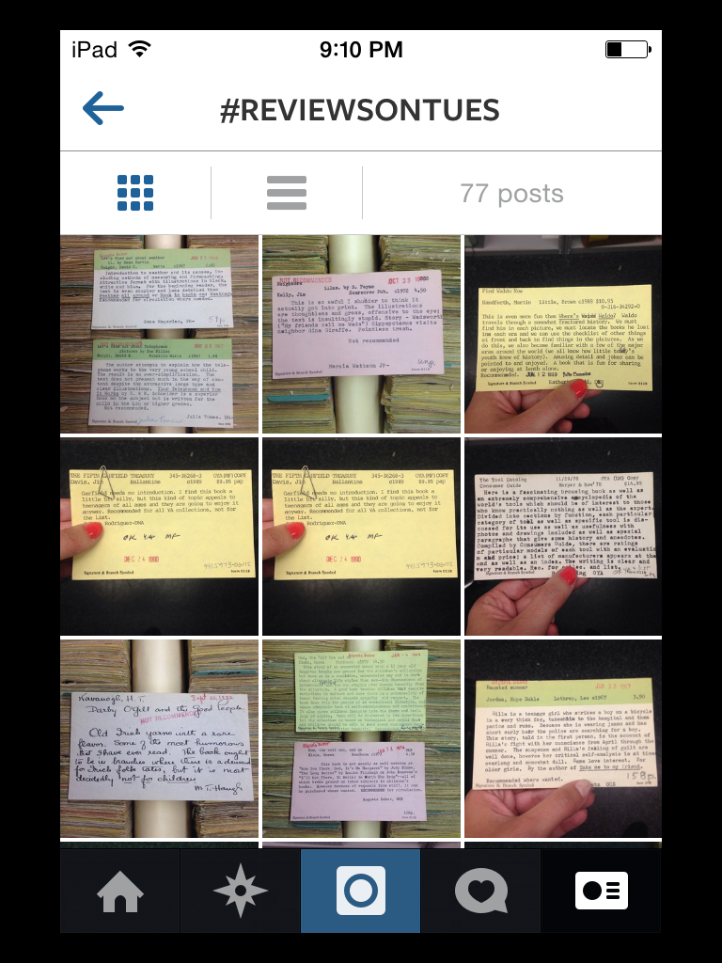
Find a # that you can use or create your own.
NY Public Library shares old reviews of books on Tuesdays.

Slide 28
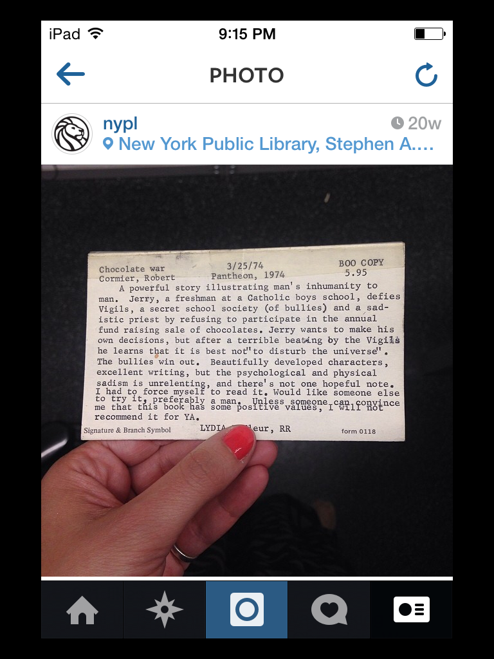
In this review The Chocolate War was not recommended to be added to the YA collection.

Slide 29
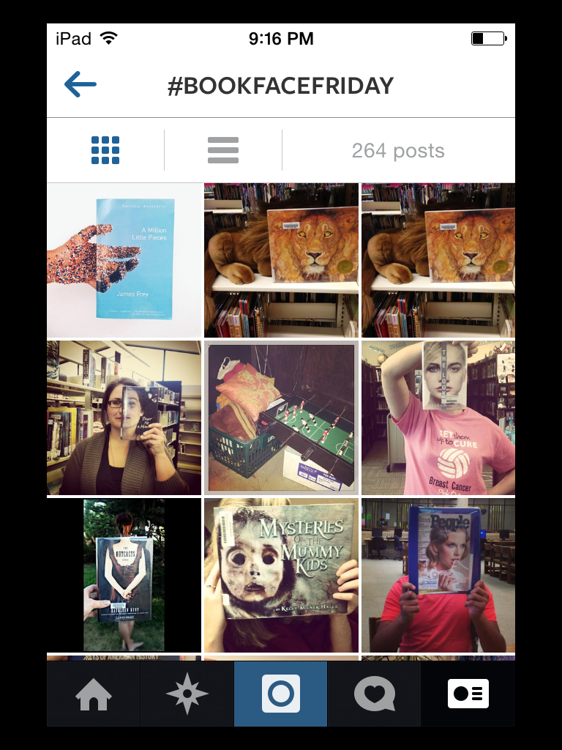
Here’s a # that both the NYPL and others use.

Slide 30
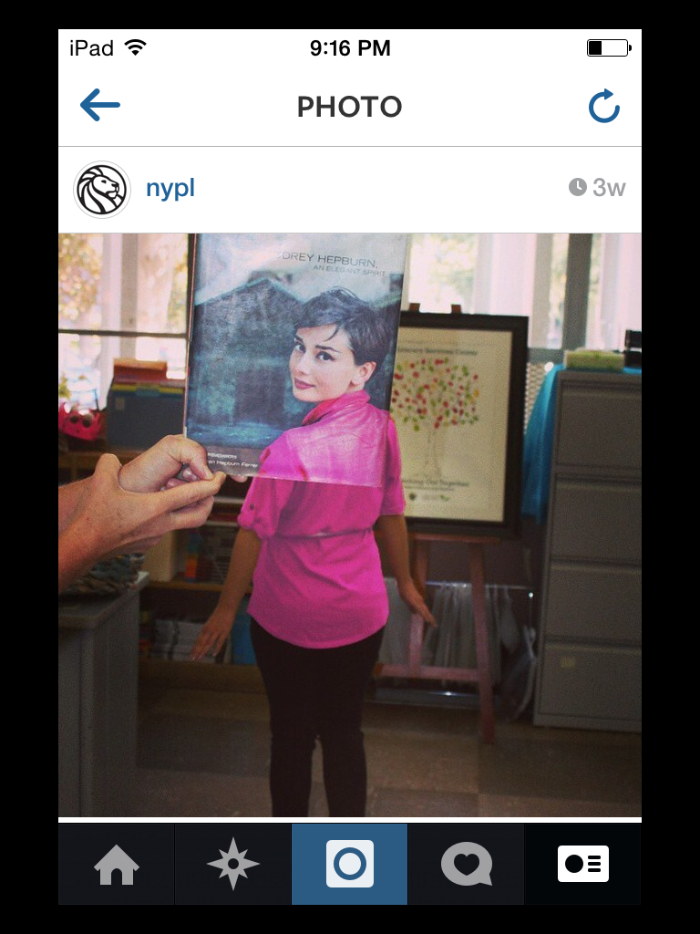
This is a great way to show off your oversized books!

Slide 31
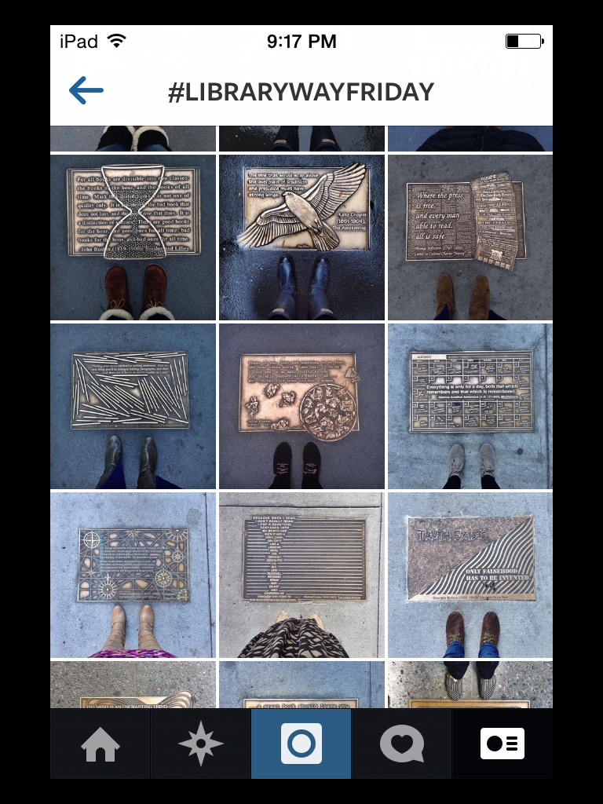
Have something unique in your building or around your building. Social media is the perfect place to show it off!

Slide 32
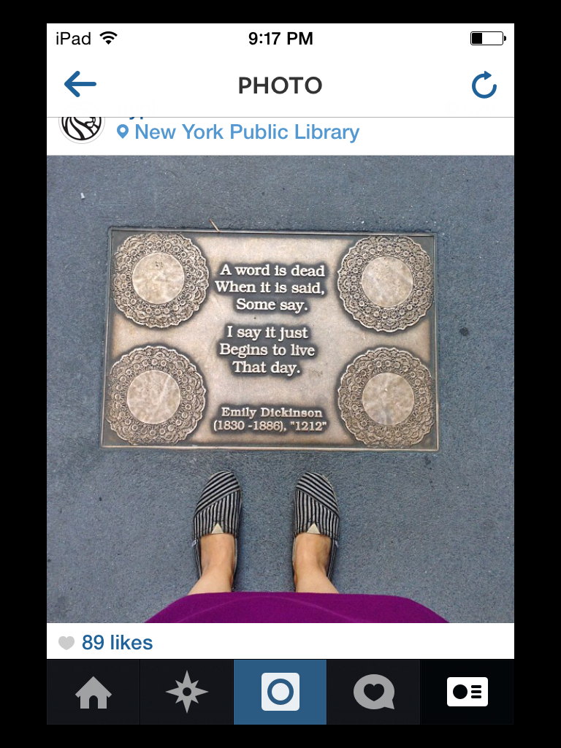
These are plaques that are on the street outside the main branch of the NYPL

Slide 33
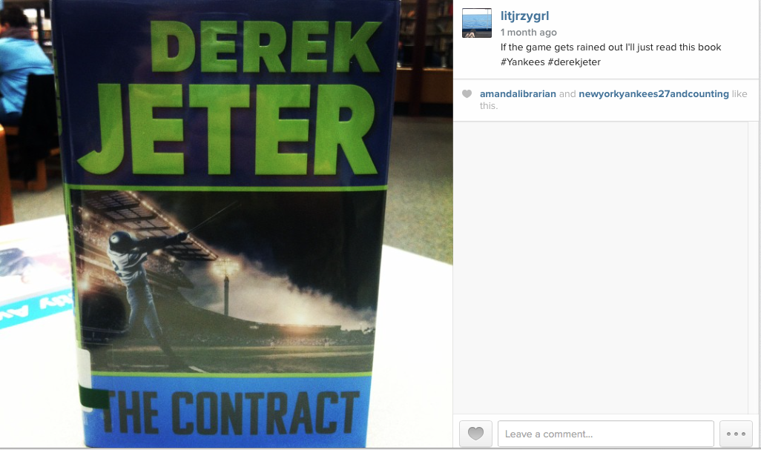
Share books that are timely.
This book came out around the time Derek was playing his last game.

Slide 34
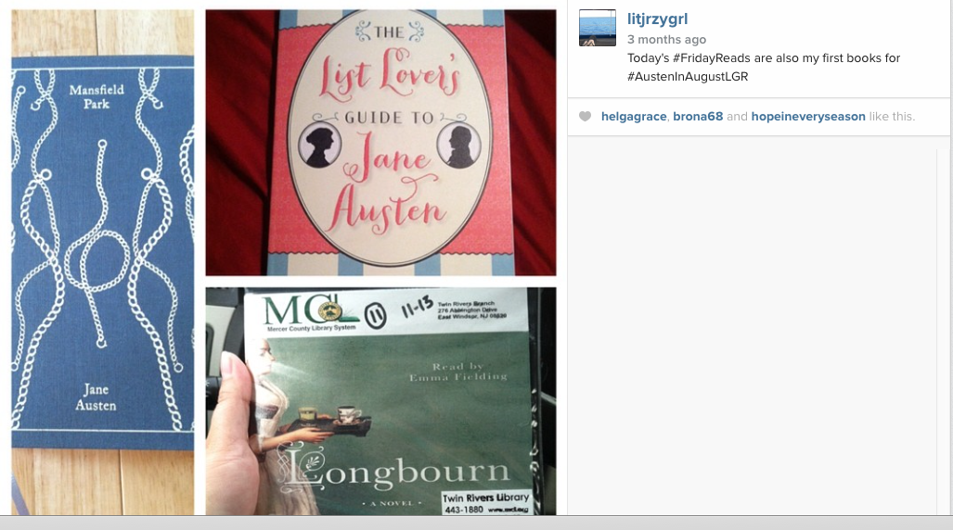
Share similar themed books for different events, deaths, birthdays, ect.

Slide 35
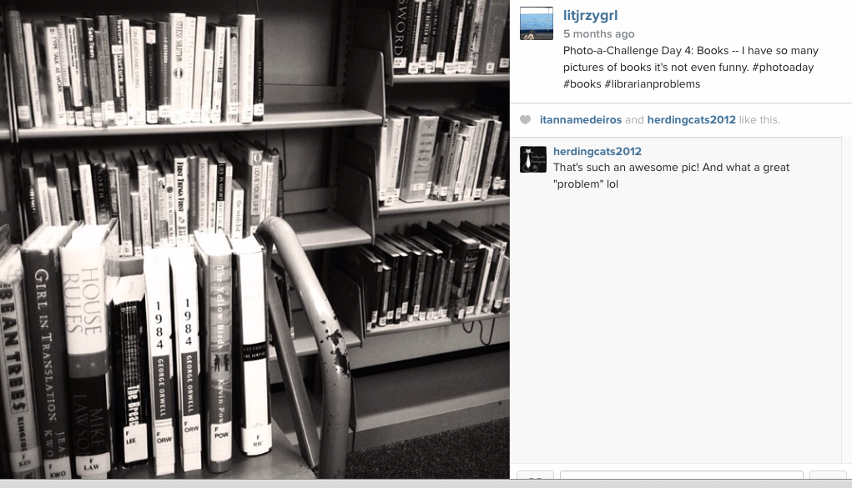
Take #shelfies

Slide 36
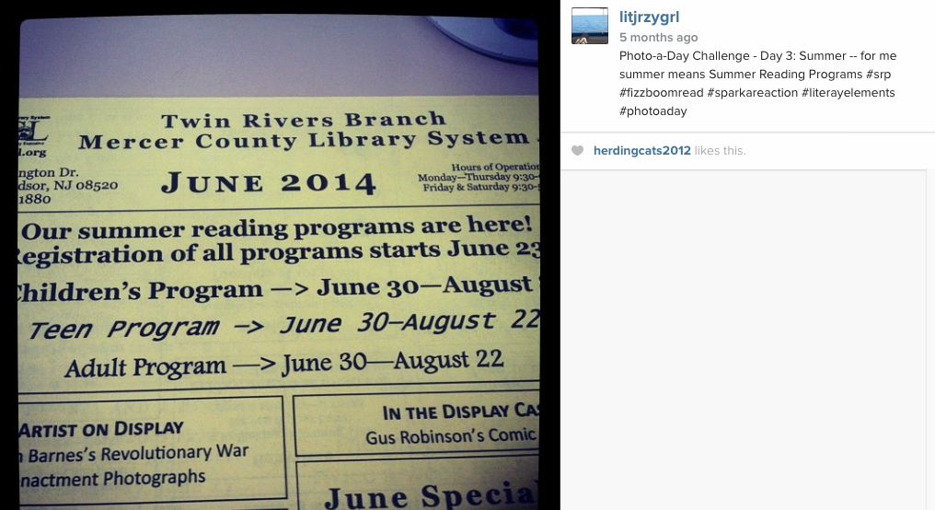
Share library programing

Slide 37
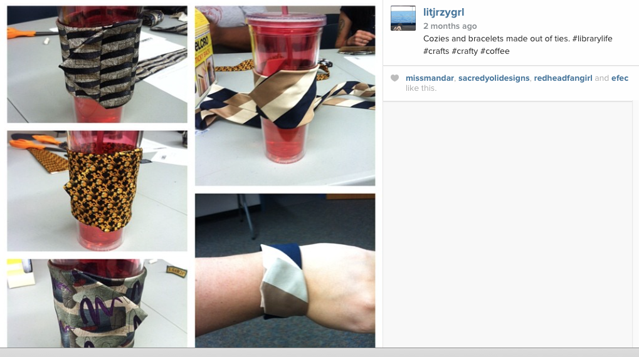
Here’s an adult craft of turning a tie into a travel mug cozy and then we made matching braclets.

Slide 38

What is Pinterest and Why Should My Library Care?
Visual Content Sharing Site
Over 70 Million Users
Longer user engagement – 15.8 minutes per session*
It taps into new trends for collections discovery
* Omnicore.com - 30 Reasons Why Pinterest Will Rule Social Media in 2014
Notes:
IF you haven’t been living under a rock then you have probably heard a little bit about Pinterest. Maybe you have heard people talking about Pinning things or repinning. Pinterest is a social website that allows users to create online interest boards. Remember cutting out recipes, decorating ideas, outfits you wanted to get and tacking them to a corkboard? Pinterest takes that idea and makes it available online and allows you to share your interest boards with others.

Slide 39
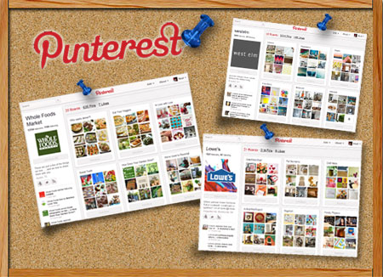

Slide 40
Ways Libraries are Using Pinterest
Curate Reading Lists
Sharing New Acquisitions
Promoting Library Activities
Showcasing Historic Collections
Collecting Display Ideas
Getting Inspired for Library Programs
Highlighting Staff Members (Staff Picks Boards)

Slide 41
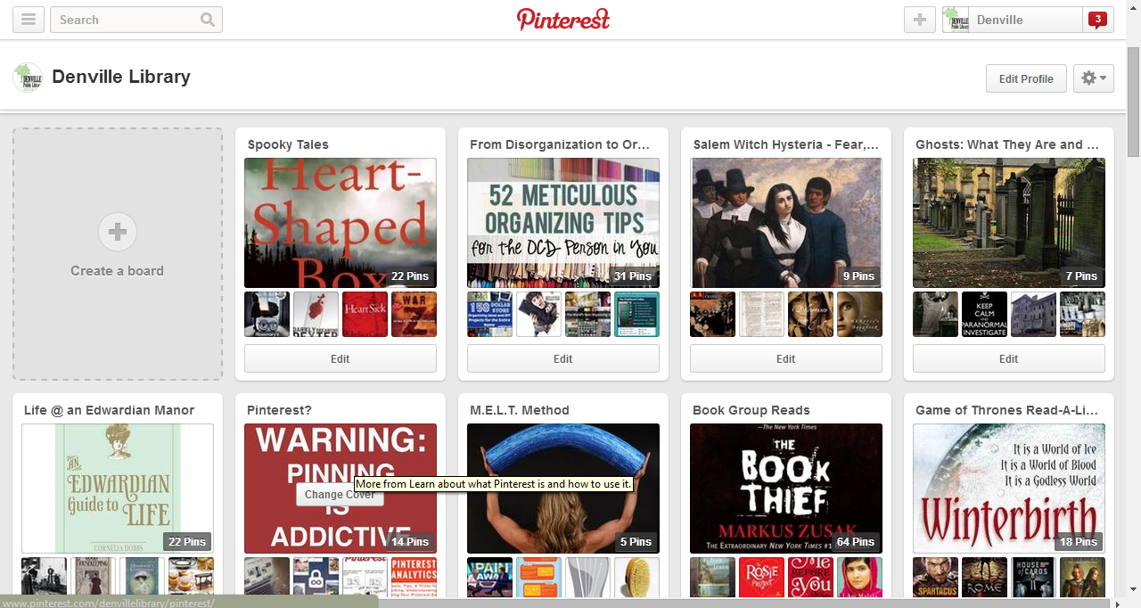
Boards?
Notes:
I maintain the Pinterest account for my library. I have a board for each adult program we do. Those boards first feature books from our catalog that pertain to the program and then I fill the boards with images and other pins relating to the topic. We also have a board for our book group and for seasonal reading. Spooky Reads, Holiday Reads, etc.

Slide 42
Other Boards
Get Caught Reading
Words, Words, Words
Library Crafting
Literary Eats
Spaces and Places
Book Displays/Marketing
Summer Reading
Sky is the limit – use your imagination!
Notes:
Have fun – Pinterest experts recommend beginning with five to ten boards with ten pins each. Set aside time weekly if not several times a week to pin. There are programs out there that will allow you to schedule your pins but I have not used them. I try to vary the time of day that I do my pinning for the Library and to which boards I pin. You don’t want to pin 15 pins about a particular subject as your followers might get annoyed.

Slide 43
Libraries to Follow
Denville Public Library
Belmont Public Library – All Things Jane Austen
Bernardsville Public Library – Before they Were Films
Statesboro Regional Public Library System - Awful Books
NY Public Library- #ireadeverywhere
SE Library – A is for App
Notes:
Do a search for Public Libraries and then click on pinners. Search around through some of the libraries that are already on pinterest to see what they are doing in terms of board and pins. Then start pinning!

Slide 44
Outreach Marketing
Take advantage of all community opportunities
Participate in as many events and activates in your town
Examples
Town farmers markets
Craft shows
Fairs
Ect.

Slide 45
Outreach Marketing
Try to get a spot where you can have a physical presence in the community
If they will let you, set up a table and be visible to promote the library to those who never come into your building
Places to try can include but aren’t limited too:
The REC center, local pizza parlor, grocery store, Starbucks

Slide 46
Outreach Marketing
Host a Volunteer Fair
Host a Business Fair or Speed Networking Event
Partner with local Businesses
Facebook campaign – Where is your library card in the community
See if the business will donate a prize for the winner who guesses the business location
Partner with a local business who will offer a % of sales when residents show their library card and then promote the list in the building and online.

Slide 47
Outreach Marketing
Partner with SCORE
Get involved with your local Chamber, Rotary, Kiwanis, etc.
Encourage local groups to meet in your building and partner with them for initiatives
Examples – working with Poetry Group and hosting a monthly poetry program
Work with the high school video club and hosting a contest for the best video promoting the library

Slide 48
Outreach Marketing
Partner with ESL and Literacy groups
Partner with the Senor Community
Host a Game Night, Open Mike Night

Slide 49
Outreach Marketing
Partner with the local theatrical group
Take advantage of your staff’s abilities
Example – if a staff member has a theatrical background – they might want to work with Teens to produce and perform a theatrical production

Slide 50
Thank you!
Reader’s Advisory Roundtable

